Slide 1
Capstone Engagement
Assessment, Analysis, and Hardening of a Vulnerable System

Slide 2
Table of Contents
This document contains the following sections:
01
Network Topology
02
Red Team: Security Assessment
03
Blue Team: Log Analysis and Attack Characterization
Hardening: Proposed Alarms and Mitigation Strategies
04

Slide 3
Network Topology
‹#›

Slide 4
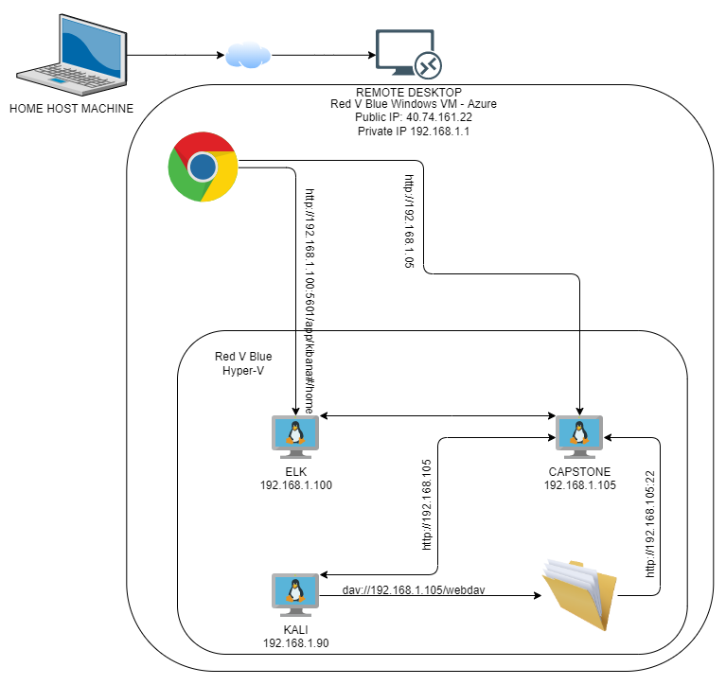
Network Topology
Network
Address Range: 192.168.1.0 -
192.168.1.255
Netmask: 255.255.255.0
Gateway: 192.168.1.1
Machines
IPv4:192.168.1.1
OS: Windows
Hostname:ML-RefVm-684427
IPv4: 192.168.90
OS: Linux (Kali)
Hostname: Kali
IPv4:192.168.1.105
OS: Linux (Ubuntu)
Hostname:Server1 (Capstone)
IPv4: 192.168.1.100
OS: Linux (ELK)
Hostname: ELK
PORT 9200

Slide 5

Red Team
Security Assessment
‹#›

Slide 6
Recon: Describing the Target
Nmap identified the following hosts on the network:
Hostname | IP Address | Role on Network
ML-RefVm-684427 | 192.168.1.1 | Hyper V Manager/Gateway
ELK | 192.168.1.100 | ELK Server
Server1 | 192.168.105 | Capstone Machine
Kali | 192.168.1.90 | C2

Slide 7
Vulnerability Assessment
The assessment uncovered the following critical vulnerabilities in the target:
Vulnerability | Description | Impact
Directory listings are exposed CWE-548 Click link for full description | A directory listing is inappropriately exposed, yielding potentially sensitive information to attackers. | Attackers can gather sensitive PII from open directories. This information can be used to launch attacks and gain path traversal.
Sensitive Data exposure CWE-916 Use of a password Hash With Insufficient Computational effort CWE-522 Insufficiently protected credentials | The usernames were displayed freely and easily on the webdav server and were in a predictable format. The password hash was displayed text and was easily cracked. The server also referred to secret files in clear text. | This has big implications as it makes it easy to guess usernames for a potential brute force attack
Brute Force Password Attack CWE-307 Click link for full description | Hackers can attempt to crack passwords with known user names by flooding the login page. | Simplistic passwords are easily cracked and attackers can gain access to the server and data.

Slide 8
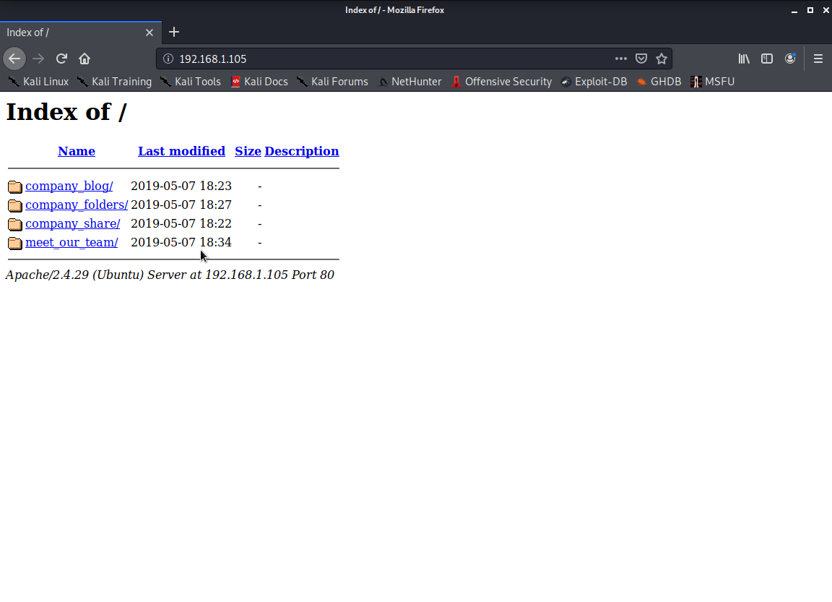
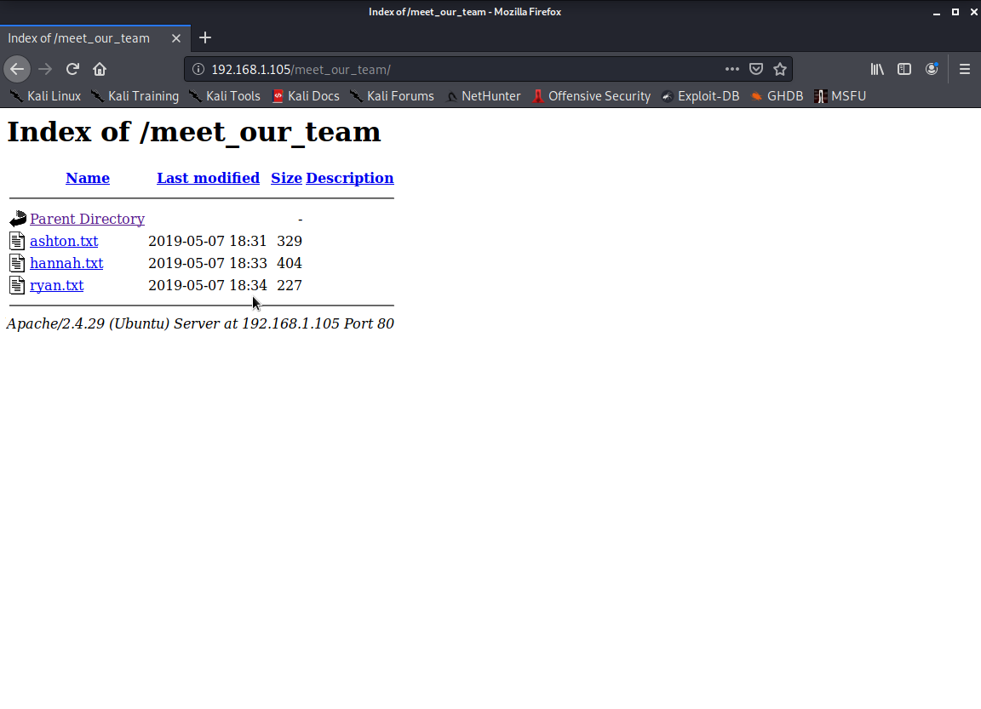
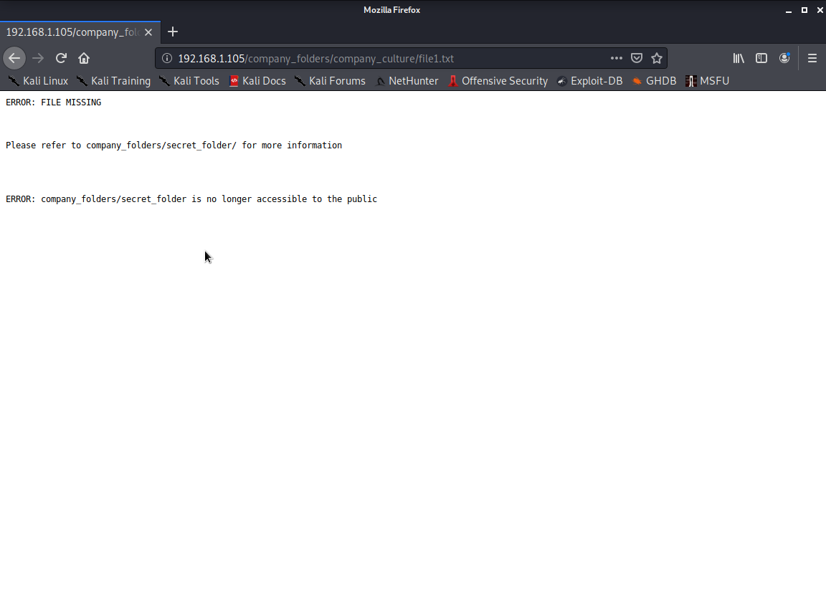
Exploitation: Directory Listings Exposed
01
02
03
Tools & Processes
These publicly exposed directory listings are a gold mine of information to a seasoned hacker. By simply navigating to the company website via a standard web browser we could start gathering intelligence for the attack.
Achievements
By clicking through each of these links we were able to gather relevant PII on three people working there. Ryan, Ashton and Hannah. We were also able to see the mention of a secret file.

Slide 9
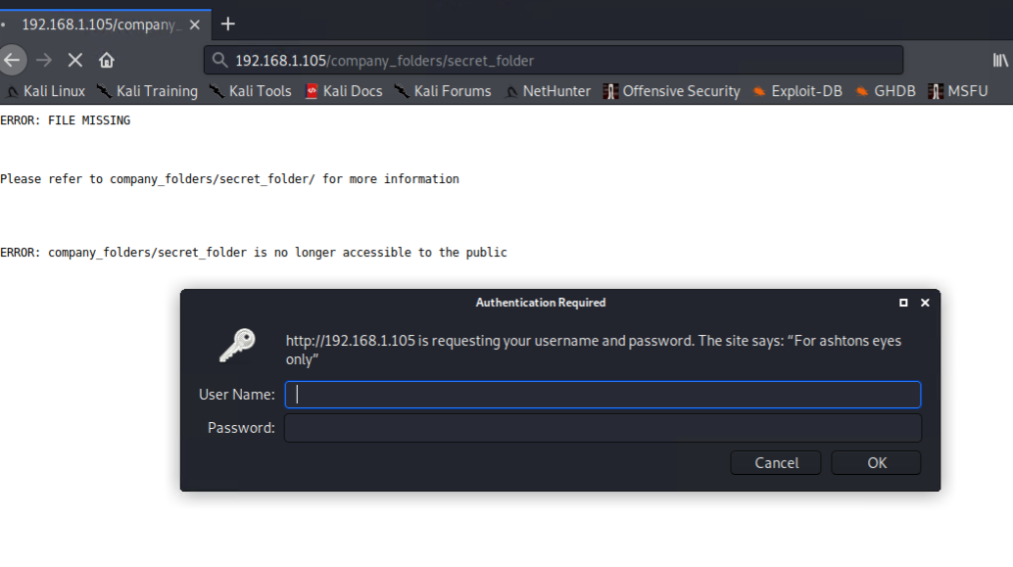
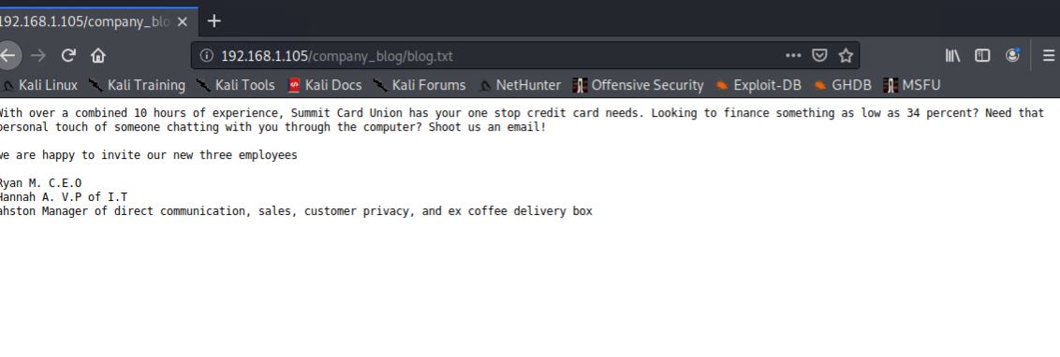
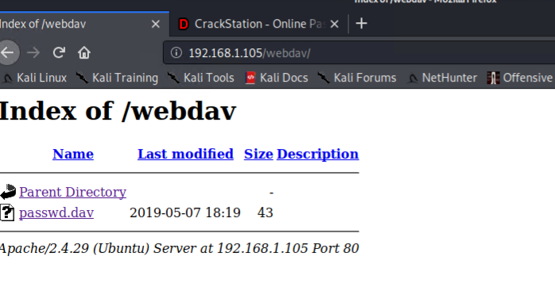
Exploitation: Sensitive Data Exposure
01
02
03
Tools & Processes
Webdav and the secret_folder contained text the usernames of employees, a secret file and the hashes for passwords.
Achievements
Using the server access and the potential usernames of the employees given we were able to use hydra (next slide) to mount a brute force attack on the secret_file login prompt.
Also we were able to crack the hash, using crackstation.
[INSERT: screenshot or command output illustrating the exploit.]

Slide 10
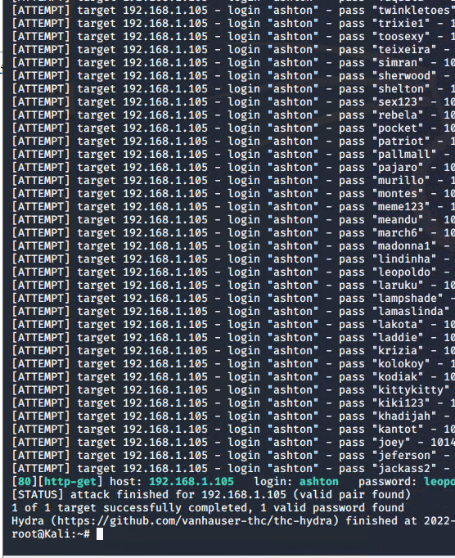
Exploitation: Brute Force Attack
01
02
03
Tools & Processes
Used Hydra to brute force attack: username ashton.
hydra -l ashton -P /usr/share/wordlists/rockyou.txt -s 80 -f -vV 192.168.1.105 http-get /company_folders/secret_folder
Achievements
The brute force attack reavlealed that Ashton uses a weak password: leopoldo.
This username and password granted us access to the secret_folder.
The secret_folder revealed Ryan’s hashed password and other company details.
[INSERT: screenshot or command output illustrating the exploit.]

Slide 11
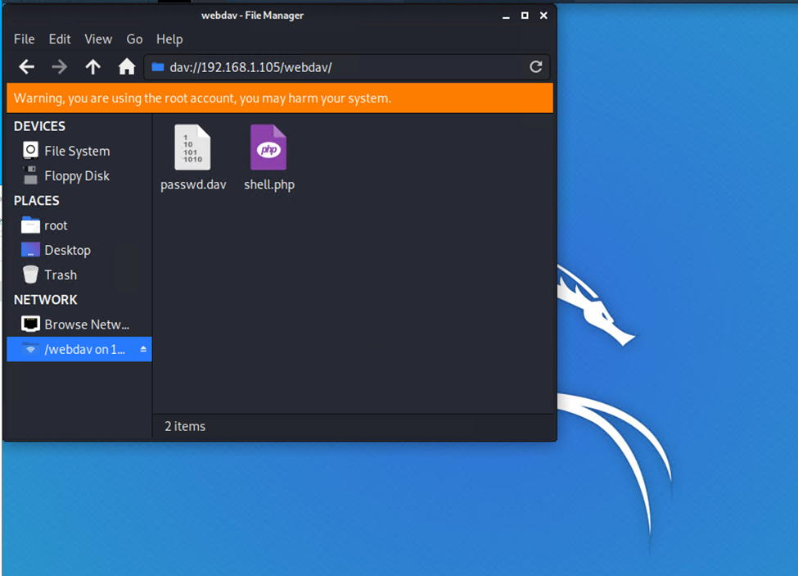
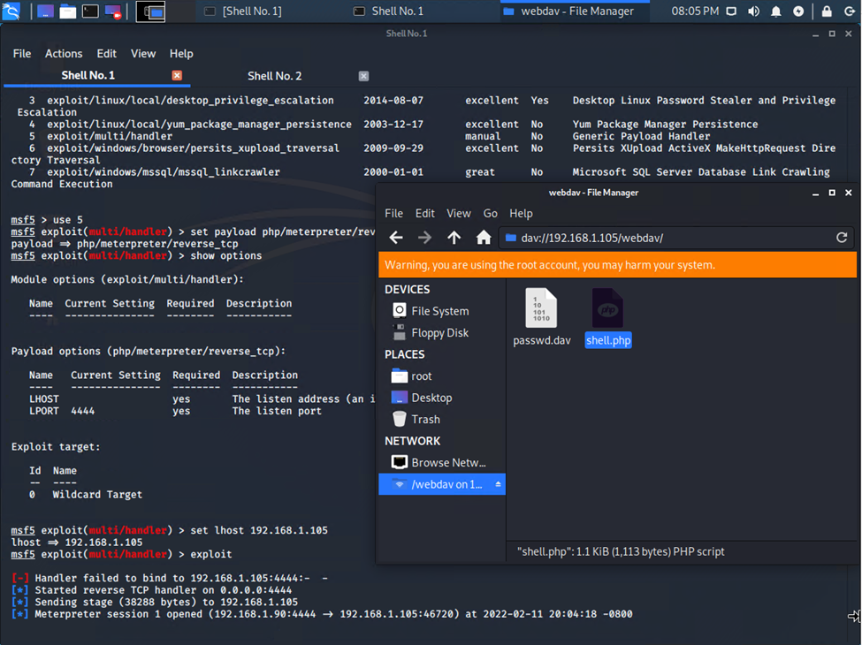
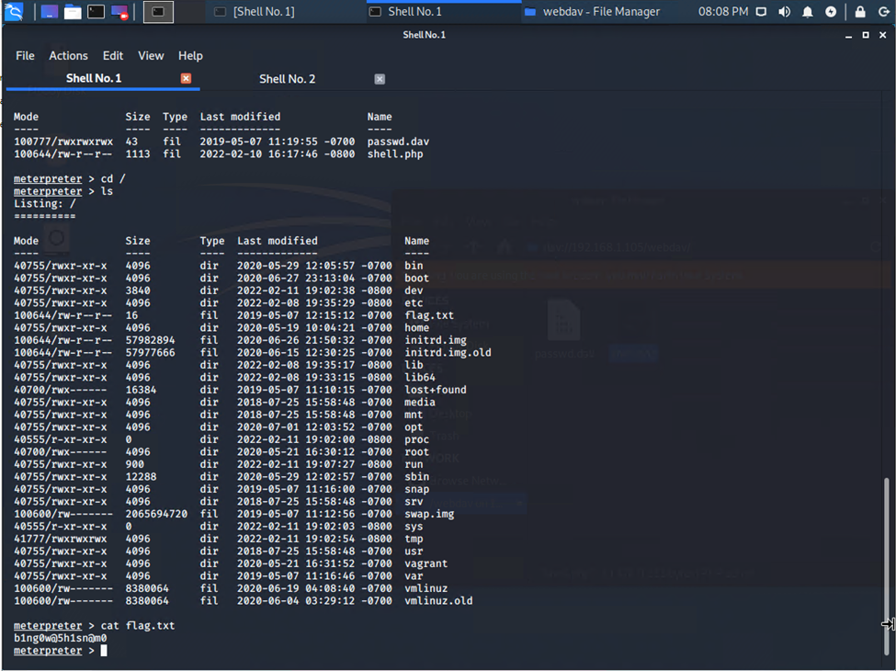

Exploitation: Establishing Meterpreter Shell
Created custom payload using MSFvenom, and used the file system on the Kali machine upload payload to the webdav server.
Once uploaded, I was able to access the payload through the webdav server and with the browser.
Set up listener with Metasploit and set the lhost to the victim IP.
Opened the payload with the Kali box through the webdav server on the victim computer.
Got a meterpreter shell on the victim computer, and changed directory to the root directory. Within this directory was the flag.txt file.

Slide 12

Blue Team
Log Analysis and Attack Characterization
‹#›

Slide 13
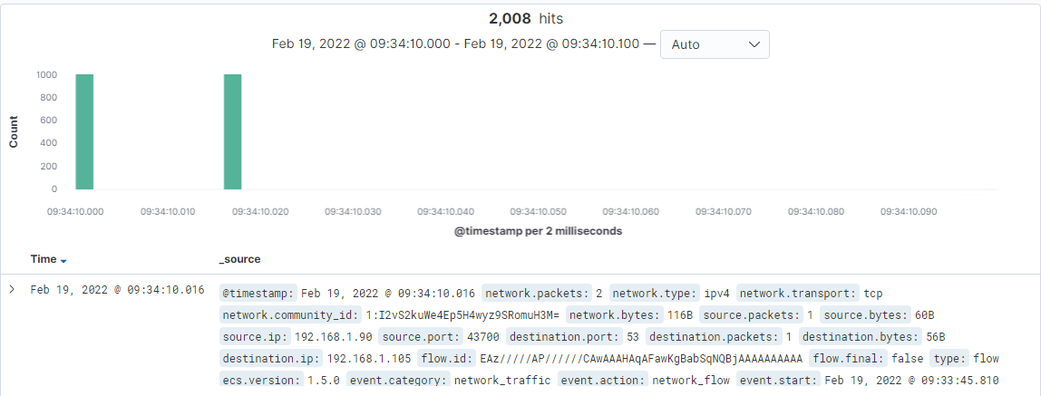
Analysis: Identifying the Port Scan
source.ip : 192.168.1.90 AND destination.ip : 192.168.1.105
This port scan returned 1004 results each time it was ran.
Each hit contains 1 or 2 packets.
user_agent.original shows the Nmap Scripting Engine was used.

Slide 14
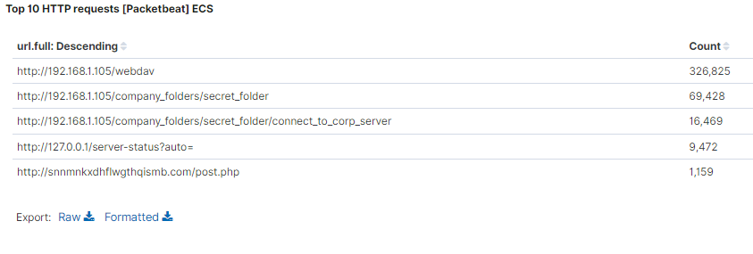
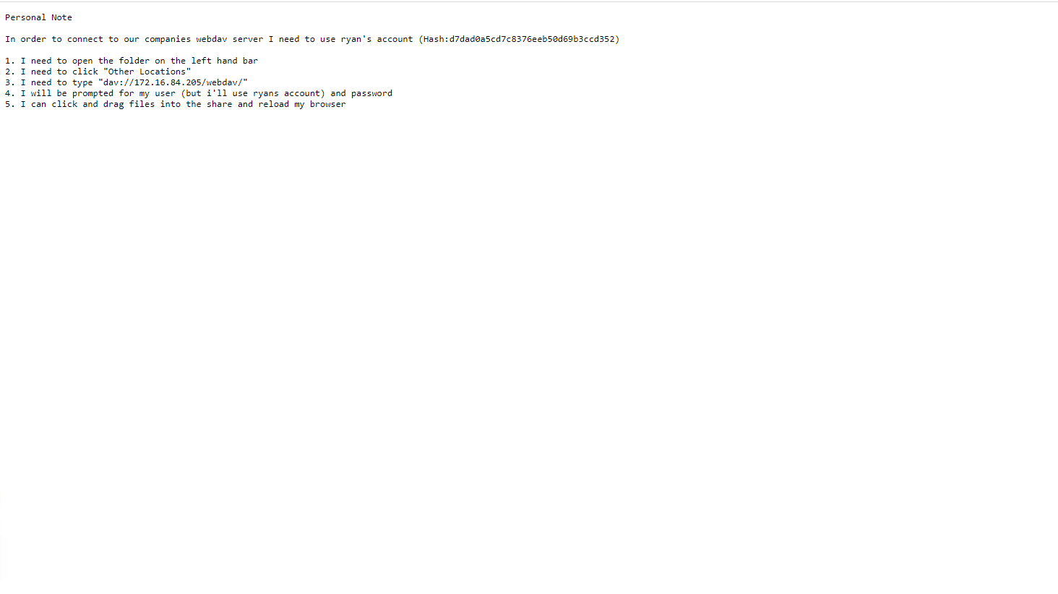
Analysis: Finding the Request for the Hidden Directory
The attack occurred 20220209 at 0139AM ZULU
69,428 request were made due to the brute force attack.
This file contained the connect_to_corp_server file.

Slide 15
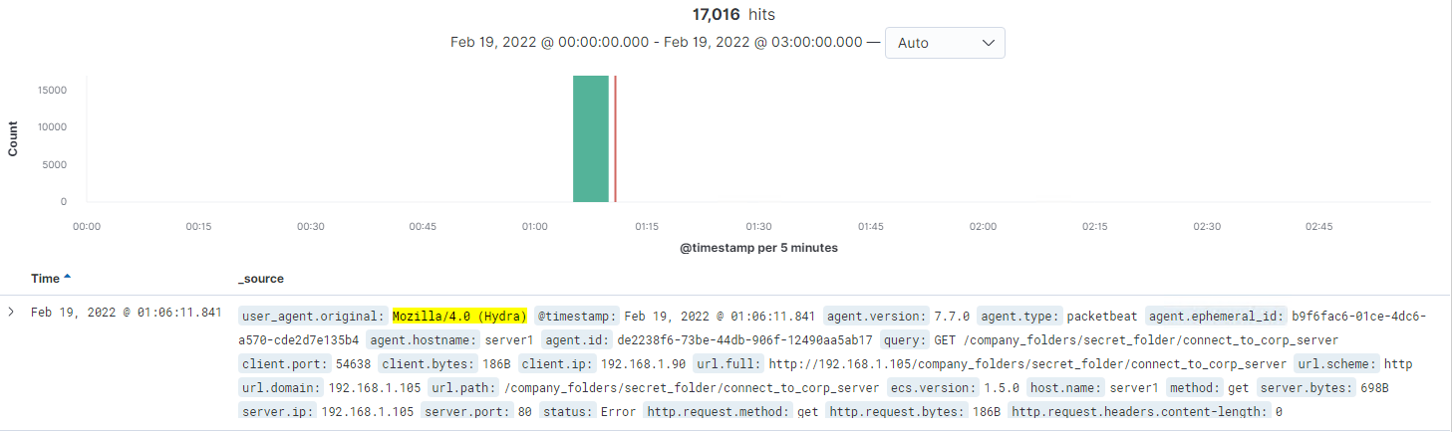
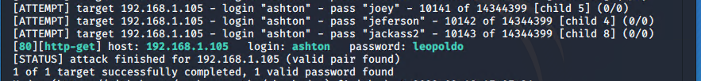
Analysis: Uncovering the Brute Force Attack
17,016 requests were made in this attack.
I this attack again 2/18 for cleaner results for this presentation. Original attack was on 2/9.

Slide 16
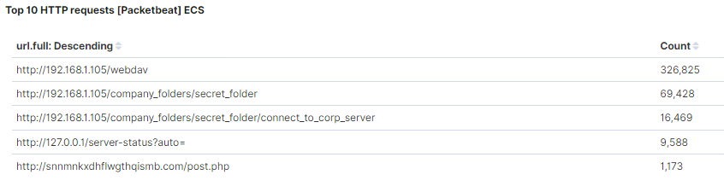
Analysis: Finding the WebDAV Connection
NOTE: These large numbers are due to multiple (practice) brute force attack attempts .
Multiple brute force attack attempts were made against this directory. Specifically, 326,825 requests were made to the webdav directory.
Once the webdav directory was located and opened with, the contents were viewed. This was a passwd.dav file, which contained a hash of Ryan’s password.

Slide 17
Blue Team
Proposed Alarms and Mitigation Strategies
‹#›

Slide 18
Mitigation: Blocking the Port Scan
What kind of alarm can be set to detect future port scans?
An alert that triggers when port scanning is detected or any use of nmap occurs having alerts tailored for varying levels of severity and aggression.
What threshold would you set to activate this alarm?
A threshold of 10 – 20 hits should be the set for port scans with anything above 50 - 100 triggering a more critical alert.
What configurations can be set on the host to mitigate port scans?
Configurations such as making sure all unnecessary ports are closed and the services are updated. Whitelisting the sources that are allowed to port scan and blocking all others as well as limiting the information returned from a scan by filtering ports such as 7000, 7004 and 7016. Configuring firewall settings will also help limit inbound connections.

Slide 19
Mitigation: Finding the Request for the Hidden Directory
What kind of alarm can be set to detect future unauthorized access?
An alert that notifies you when unsuccessful password attempts have been made setting thresholds for low (around 3-5) and severe ( around 5 – 20).
An alert that triggers when unauthorized access attempts are detected.
What configuration can be set on the host to block unwanted access?
Hardening the access credentials by making more complicated passwords, non predictable usernames, multifactor authentication and password failure timeouts.
Data exposure needs to be reviewed and eliminated to prevent easy discovery of secret files.

Slide 20
Mitigation: Preventing Brute Force Attacks
What kind of alarm can be set to detect future brute force attacks?
An alert needs to be set on all levels of credentials entry and prompts to monitor for password failures and notify if there are more than 3-5 failed attempts and prioritize 10-20 failed attempts.
What configuration can be set on the host to block brute force attacks?
Creating a staggered lockout for accounts that fail a password more than 3-5 times and sending an alert for review and reset can prevent brute force attacks. The standard hardening practices such as stronger password strength, multifactor authentication, non predictable usernames will also make brute forces more difficult to succeed.

Slide 21
Mitigation: Detecting the WebDAV Connection
What kind of alarm can be set to detect future access to this directory?
Trigger an alarm that monitors unauthorized access of any kind from IPs without permission if severe and an alert should be set if 1 occurs.
What configuration can be set on the host to control access?
Webdav is a decently unsecure application so looking into more secure products as well as making access to it more secure by limiting the areas it can be accessed from limited to company machines. Making the access credentials more complicated using better passwords, usernames and multi factor authentication for access and keeping everything patched and up to date.

Slide 22
Mitigation: Identifying Reverse Shell Uploads
What kind of alarm can be set to detect future file uploads?
We can create an alert that triggers when php files are uploaded from remote users. Another alert that should be considered is when access to the secret_folder is requested. This alert could send an email to the person requesting access with a code to enter into the login window for 2 factor authentication.
What configuration can be set on the host to block file uploads?
As mentioned above, multi-factor authentication for access to the secret_folder, or the entire server for remote users. Another option would be not to allow remote access to this server.

